Slide 1
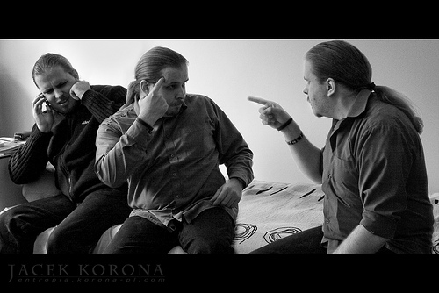
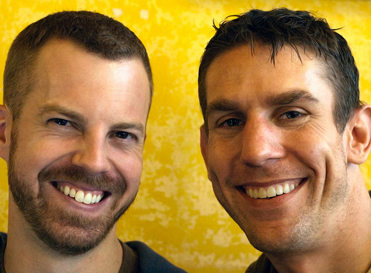
Evaluating Requirements
http://www.flickr.com/photos/korona-pl/2857014100/sizes/m/ http://www.flickr.com/photos/carbonnyc/3199834377/sizes/m/

Slide 2
Announcements
Homework 1 grading will be finished by weekend
You will get the grades on Canvas by weekend
You can pick up the HW from office hours Tue (Caius: 2:30 pm, or after class).
The 2 TAs each graded 8 teams, we will keep the same TA grading your HW through the term
If you have questions please see them (or me), but better see them
I wont have office hours on Wed (traveling)

Slide 3
Announcements
Course reserve for the text book – Valley Library
Review session for diagram notations?
Canvas organization
Modules working?

Slide 4
What are some reasons to create GREAT software?
To improve the world
Designing software badly can harm the world
To meet customers’ needs
Designing software badly can harm customers
To get a paycheck
Designing software badly can get you fired
To have some fun
Designing software badly just plain feels bad

Slide 5
Customers and users should be your friends
They probably know much more about the problem than you do.
They probably have some ideas about how to solve the problem.
They are your best resource for discovering your own mistakes before you start to code.

Slide 6
Good requirements are…
Correct:
Consistent :
Unambiguous:
Complete:
Relevant:
Testable:
Traceable:
Notes:
Take a moment to think about the requirements that you submitted – how many of these criteria do you think your RE satisfied. Would we be able to check it?

Slide 7
Good requirements are…
Correct: They have to say the right things.
Consistent : They can’t contradict each other.
Unambiguous: Each must have 1 interpretation.
Complete: They cover all the important stuff.
Relevant: Each must meet a customer need.
Testable: There must be a way to tell if they are satisfied.
Traceable: There must be a way to determine their origin.
Notes:
Take a moment to think about the requirements that you submitted – how many of these criteria do you think your RE satisfied. Would we be able to check it?

Slide 8
Approaches for evaluating requirements
Prototyping
Depict a design based on requirements, test if people can use it
Stakeholder review
Present diagrams to customer & engineers, get feedback
Analysis
Manually or automatically check properties of your requirements and design

Slide 9
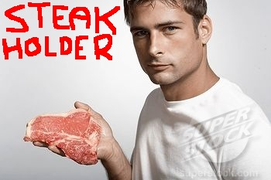
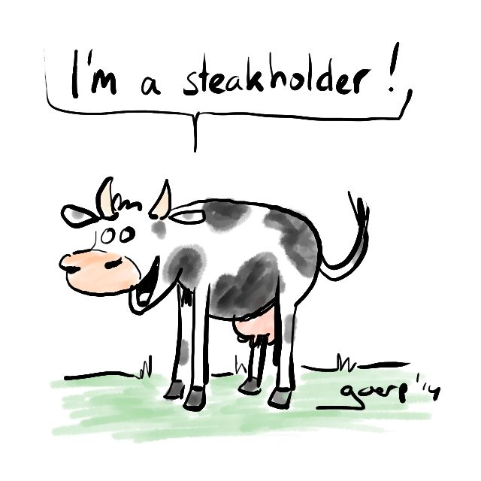


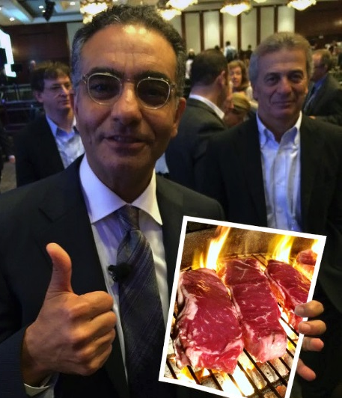
Who are Stakeholders?
http://searchenginewatch.com/article/2165890/Writing-Better-PPC-Reports
http://jaypgreene.com/2009/04/23/famous-steakholders-the-grand-finale/
http://shilipoti.blogspot.com/2011/06/steakholder.html
http://www.pinterest.com/pin/303007881151287140/
http://domaingang.com/domain-news/icann51-update-new-multi-steakholder-model-fully-approved/

Slide 10
Who are Stakeholders?
People who will be affected by the software
Customers
Users
Marketing specialists
Lawyers or auditors
Other people in users’ companies
Software engineers

Slide 11
Stakeholder review
Sit down with stakeholders
Engineers present their understanding of requirements
Stakeholders correct this understanding
Everybody discusses/argues/negotiates
Engineers revise requirements
Repeat, if necessary.

Slide 12
1. Sit down with stakeholders
Make sure that all of the “right” people attend
In advance, ask stakeholders if they know of other people who need to attend
Consciously consider having user representatives attend the meeting
But try to keep the attendee list <= 8 people
So that everybody at the meeting can be heard
So that you don’t waste $$$$
➔ People should attend if and only if their attendance would be valuable.

Slide 13
2. Engineers present their understanding of the requirements
The situation of the customers / users
Key problems faced by customers / users
Key use cases to be supported by system
Often helpful to present diagrams from the requirements definition
Visualizations of possible system interface
Often helpful to present low-fidelity prototypes
Make it clear that you welcome feedback.

Slide 14
3. Stakeholders correct this understanding
Your customer / users / other stakeholders will probably interrupt the designers
If your stakeholder says something that you don’t understand, try to get him/her to explain in terms of a concrete scenario
It’s often helpful to have a note-taker responsible for recording customer feedback

Slide 15
4. Everybody discusses requirements
Focus on concrete scenarios
A specific example of how a particular person would use the system in a certain real-world situation
An instance of a use case
Scenarios will support system testing later
Discussion is how you make sure that your requirements are correct, unambiguous, and testable

Slide 16
4. Everybody argues about requirements
Focus on risk management
What scenarios might be hard to support?
What scenarios are impossible to support?
What requirements contradict one another?
Arguing is particularly necessary when requirements contradict one another.
Arguing is ok as long as you remember that it’s a discussion among friends, not enemies
Most arguments will be among other stakeholders, not between you & the others

Slide 17
4. Everybody negotiates about requirements
Focus on prioritization, rather than eliminating support for scenarios
I only have so much time; what should I do first?
That way, reqs can be complete yet affordable.
Watch for opportunities to use incremental or iterative development processes
Incremental: is there a part that we can build really well right now, then add more parts later?
Iterative: can we do a low-quality version of the entire system, then improve it later?

Slide 18
5. Engineers revise requirements.
Update the requirements definition and specification based on the review’s results.
Every single requirement should have been reviewed with stakeholders at least once.
Keep track of what scenarios and comments came from stakeholders for each requirement
Helps to ensure relevance and traceability

Slide 19
Example: Prototyping a system for monitoring energy usage
Need some volunteers…
Who wants to pretend to be a user?
I also need four more volunteers…
1 person with experience making web apps
1 person with experience programming sensors
1 person to be note-taker
1 person to be the stakeholder review process expert
I’ll play the role of lead system designer

Slide 20
Stakeholder review
Sit down with stakeholders
Engineers present their understanding of requirements
The situation of the customers / users
Key problems faced by customers / users
Key use cases to be supported by system ->
Visualizations of possible system interface ->
Stakeholders correct this understanding
Everybody discusses/argues/negotiates
Engineers revise requirements

Slide 21
UC#1: Configure energy monitors
Actor: A home owner or business worker
Precondition: User has account on web site and has a networked computer
Postcondition: System records user’s energy usage at each power outlet

Slide 22
UC#1: Configure energy monitors Flow of events
User buys energy monitors and a USB dongle
User plugs USB dongle into computer
User plugs monitor into power outlet
Monitor wakes up and sends its id via wireless to the dongle, which shows info form on screen
User enters information about that outlet
System records information
User plugs electrical appliance into monitor
Monitor transmits on/off info to computer any time that appliance is used

Slide 23
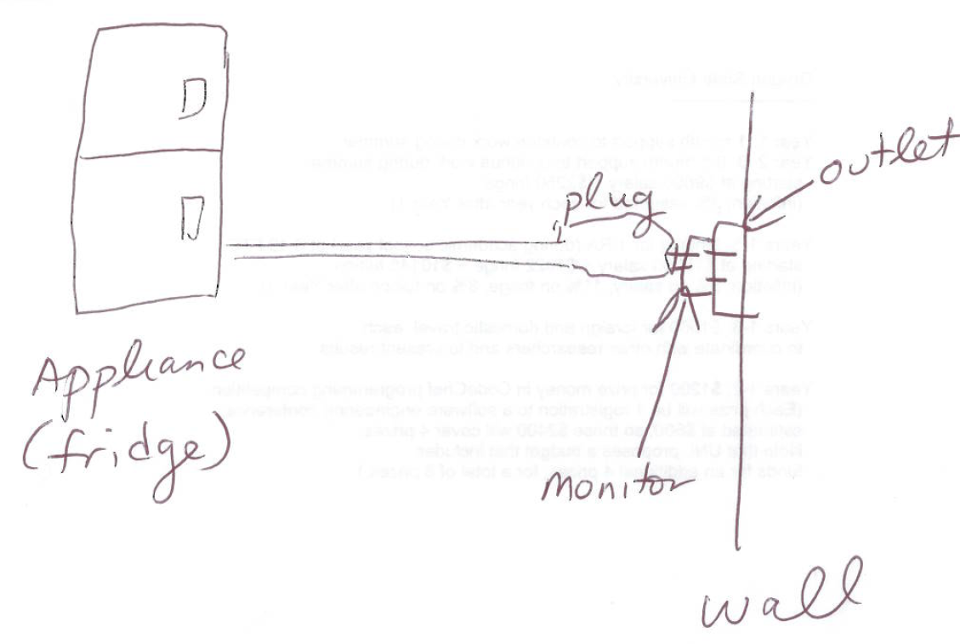
Plugging in an energy monitor

Slide 24
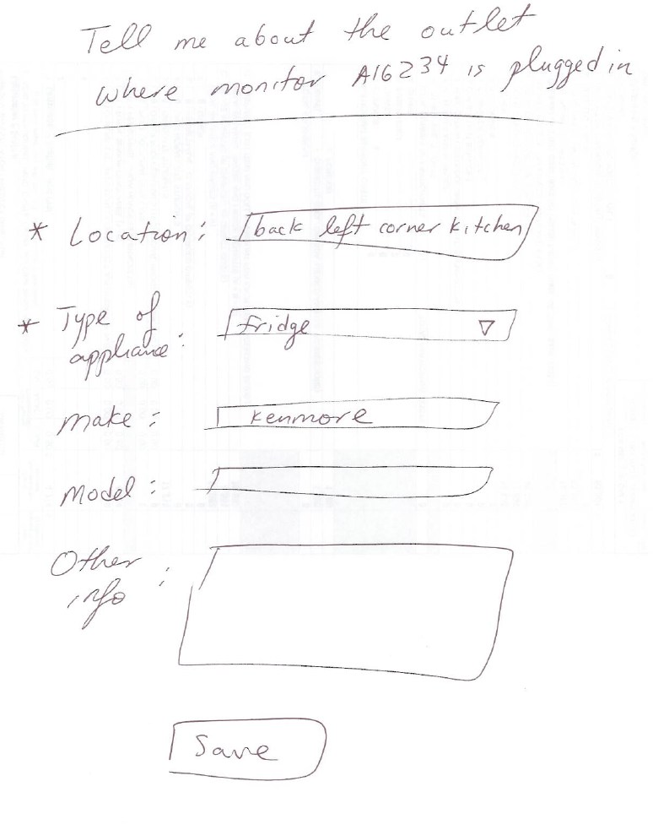
Possible user interface for configuring monitor

Slide 25
UC#2: Transmit energy data
Actor: Home owner or business worker
Precondition: Monitors have been configured and have been monitoring for a while
Postcondition: Energy usage is sent to website
Flow of events:
User turns on computer, connecting to internet
Computer dongle asks monitors to send data
Monitors transmit data to dongle
Computer forwards information to website

Slide 26
UC#3: Review online data
Actor: Homeowner or business worker
Precondition: Monitors have been sending information to website for a while
Postcondition: User can see energy usage as well as tips for reducing usage
Flow of events:
User logs into website
Website shows configurable charts showing usage
Website offers tips based on energy consumption, outlet info and external data (e.g. other user data)

Slide 27
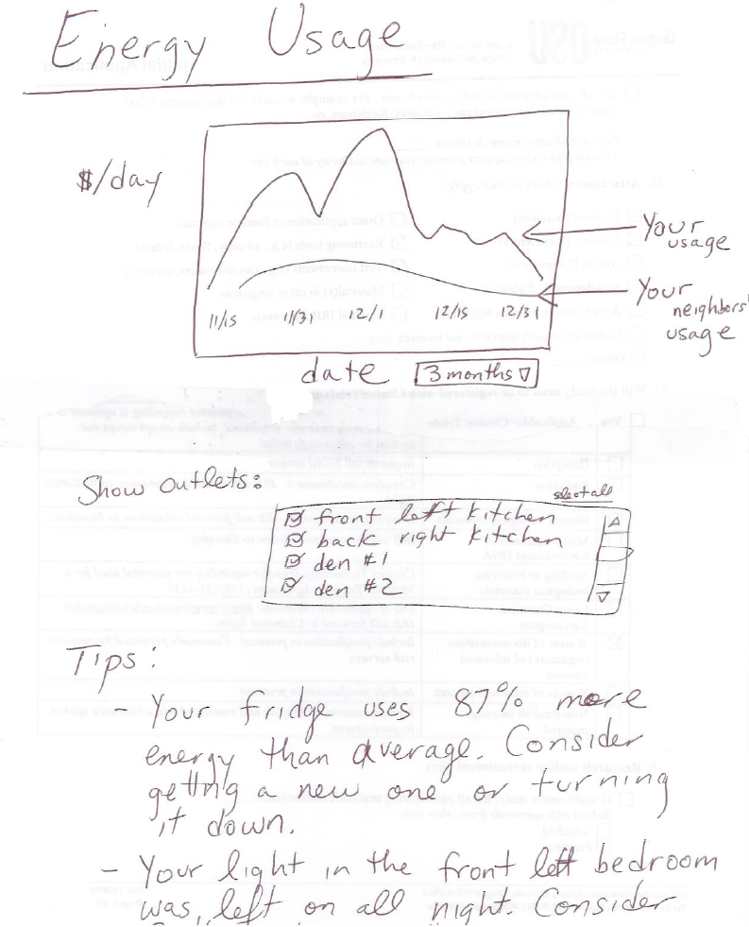
Possible user interface for reviewing online

Slide 28
Stakeholder review
Sit down with stakeholders
Engineers present their understanding of requirements
Stakeholders correct this understanding
Everybody discusses/argues/negotiates
Explain using scenarios
Identify risks
Use incremental or iterative development?
Engineers revise requirements

Slide 29
Now your turn
Write use cases for students who need to figure out:
what courses to register for the term,
whether they have the pre-requisites to register,
and register for the courses
No time conflicts
Class is still open, if not waitlist
Create simple paper prototype for each use case

Slide 30
Stakeholder Review
Who would you invite?

Slide 31
Stakeholder Review
5 member team
1 person who is going to be the user
1 person who is the system designer
1 person with experience making web apps
1 person to be note-taker
1 person to be the stakeholder review process expert (you wont have this in real reviews, but lets keep this now)
There should be another person who knows about the university registration system, constraints, etc., but we will skip this.

Slide 32
Approaches for evaluating requirements
Prototyping
Depict a design based on requirements, test if people can use it
Stakeholder review
Present diagrams to customer & engineers, get feedback
Analysis
Manually or automatically check properties of your requirements and design

Slide 33
Manual analysis
Systematically check consistency between requirements definition and specification
If you “execute” or “simulate” the use cases, would the system suffice?
If the definition says that the system has feature X, does the specification indicate how to support X?

Slide 34
Details on formal analysis
Define two formal models
Describing the requirement definition
Describing the requirement specification
Automatically check or prove if the specification satisfies the definition
Not really used by many engineers in practice
See Wikipedia (“formal methods”) or your (optional) textbook for examples

Slide 35
Strengths of each requirements evaluation technique
Technique | Especially good for | Weaknesses
Paper prototyping | -Evaluating visual requirements | -Often misses interactions between use cases
Low-fidelity prototyping | -Evaluating visual requirements | -A little expensive -Need design skills
Stakeholder review | -Evaluating fit to context | -Costs customer time
Manual analysis | -Checking for consistency | -Easy to miss errors
Formal analysis | -Can guarantee formally specifiable properties | Expensive Need formal skills

Slide 36
Strengths of each requirements evaluation technique
Technique | Especially good for | Weaknesses
Paper prototyping | -Evaluating visual requirements | -Often misses interactions between use cases
Low-fidelity prototyping | -Evaluating visual requirements | -A little expensive -Need design skills
Stakeholder review | -Evaluating fit to context | -Costs customer time
Manual analysis | -Checking for consistency | -Easy to miss errors
Formal analysis | -Can guarantee formally specifiable properties | Expensive Need formal skills
Validation:
Is your goal correct?
Verification:
Is your solution correct?

Slide 37
What’s next for you?
Finish revising Vision Statement V2
Due Saturday (10/17), 11:59pm
We will make revised vision statement V2 available for the team
Start working on HW2
In-class paper prototype testing: 10/22
Due next Saturday (10/24), 8pm
As a PDF
Upload to canvas
By one team member
Including 1 page describing each team member’s contribution to the submission [NEW]

